Slide 1
M Accelerator Sales Model Overhaul Challenge
Dated: 8th November, 2021

Slide 2
Problem Statement
The client’s annual sales event is canceled
This was a part of their primary sales activation program
This dramatic change in the environment calls for an appropriate and measured response

Slide 3
Customer Solution Proposed
We are in the business of selling heavy machinery and believe the virtual world has little to do with the buying and selling process which should necessary involve machine aesthetics, ergonomics and a feel for the outstanding piece of engineering that we are proud of manufacturing.
Given the environment we face, we do not let customer experience suffer too much even though the prospective customers are admittedly less likely to make a purchase decision vis-à-vis last year
We advise the preparation of a sales and a marketing plan based on customizable 3D CAD Drawings.
This should help put a marker in as we generate awareness and interest during the recovery period.
Qualification and evaluation will be a part of a 2-way consultative process to onboard prospective customers.
To push back the pricing pressure we will offer financing and leasing options
The demo process will involve the presentation of a computer simulated performance of the custom-manufactured machine on the shop floor

Slide 4
Profitability
Because of more customization of the machine, there will be a higher tool changeover which will result in a lower throughput and put a pressure on our unit cost. We may also be able to offer up to 30% increase in throughput using principles of manufacturing systems modeling from the stable of the Texas A&M University.
Because of increased customization and the 2-way consultative sales approach the sales cycle is likely to increase.
Conditional on everything else remaining the same, we will need to hire more salespersons due to the consultative sales arrangement which will result in a pressure on unit cost.
There will be reduced customer awareness and interest - we may need to cast a wider net with our outreach program.
Given the canceling of the annual sales event there may be price pressure too.
We begin at the top of the sales conversion funnel.

Slide 5
Worst Case Scenario Sales Conversion Funnel – With The Market Tanking
Without access to any special collateral, after qualifying, post evaluation(9.09%)
Demo (5.67%)
Sales(0.515%)

Slide 6
Proposed Consultative Sales Conversion Funnel
(Drum up awareness and interest by offering 3D CAD Drawings, Qualify), Post Evaluation (23.08%)
Demo (15.25%)
Sales(3.52%)

Slide 7
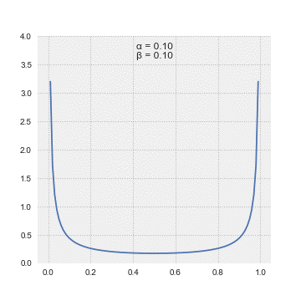
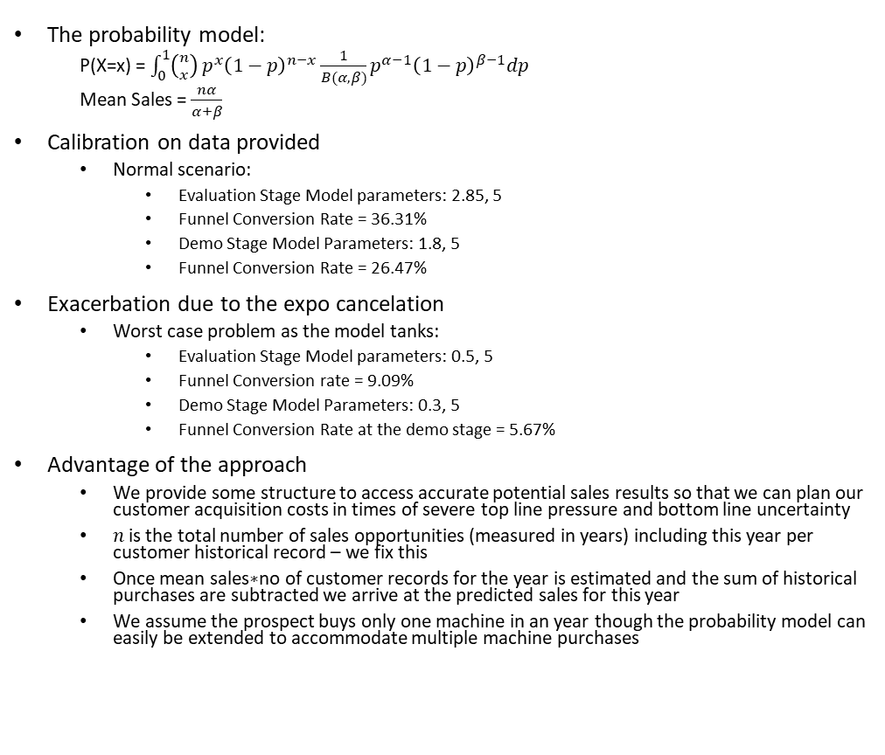
Modeling Uncertainty
Beta Probability Density Function
The probability model:
P(X=x) = $\int_{0}^{1}{\left({n \atop x}\right)}p^{x}{\left(1−p\right)}^{n−x}\frac{1}{B(α,β)}p^{α−1}{\left(1−p\right)}^{β−1}dp$
Mean Sales = $\frac{nα}{α+β}$
Calibration on data provided
Normal scenario:
Evaluation Stage Model parameters: 2.85, 5
Funnel Conversion Rate = 36.31%
Demo Stage Model Parameters: 1.8, 5
Funnel Conversion Rate = 26.47%
Exacerbation due to the expo cancelation
Worst case problem as the model tanks:
Evaluation Stage Model parameters: 0.5, 5
Funnel Conversion rate = 9.09%
Demo Stage Model Parameters: 0.3, 5
Funnel Conversion Rate at the demo stage = 5.67%
Advantage of the approach
We provide some structure to access accurate potential sales results so that we can plan our customer acquisition costs in times of severe top line pressure and bottom line uncertainty
$n$ is the total number of sales opportunities (measured in years) including this year per customer historical record – we fix this
Once mean sales$∗$no of customer records for the year is estimated and the sum of historical purchases are subtracted we arrive at the predicted sales for this year
We assume the prospect buys only one machine in an year though the probability model can easily be extended to accommodate multiple machine purchases

Slide 8
Sales Impact
Proposed Solution
A resurrection as we respond
Evaluation Stage Model parameters: 1.5, 5
Funnel Conversion rate = 23.08%
Demo Stage Model Parameters: 0.9, 5
Funnel Conversion Rate at the demo stage = 15.25%
Increase in the sales conversion rate vis-à-vis the worst case scenario by 584% post qualification.

Slide 9
Impact on the Balance Sheet
We advise full utilization of our marketing and demo resources in face of adversity to revamp our sales model.
Sales force and manufacturing capacity is not a constraint given the slack.
Fixed cost (minus the expo and the flying in of the customer cost) and the variable unit cost remain unchanged.
We will utilize all the expenses set aside for the expo to produce accurate 3D CAD Drawings for our prospects. We may be able to save on the customer flying in cost on account of suppressed sales by working with a demo simulation software and our R&D team. Once we get the commitment from the prospect, we can have them fly in.
We will also offer financing and leasing options to ease price pressure.
In normal times we would expect to see around 1100 qualified leads for each 100 sales in a year (from an expo of size 5000? )
With an awareness and interest in our product of around 20-25% post qualification?
We can expect to see 300 qualified leads with our solution after e-mailing in the 3D CAD Drawings to 1000 prospects from our in-house database.
Competitive advantage:
If we are down on sales and net profit today like our competitors, we improve upon the sales figures, increase loyalty through customization and hit back on the rebound once the recovery period ends.
With accurate prediction of our sales figures during this uncertain period, we are not going in blind on expected sales figures and can afford to be more secure and forward looking and cast a wider net in our customer outreach program.

Slide 10
Way Forward
The prescribed model can be calibrated better with more customer and company data
We would like to have access to historical prospect-level funnel data to illuminate the year-by-year sales risk mitigation part of our model
We are open for further consultative fee-based confidence building engagement
We will offer scenario-based sensitivity analysis
Recovery period it is. We do not think the 3D CAD Drawings will have to be persisted with for too long as the primary means of acquiring clients
Lets get back to doing business the old fashioned way by getting our machines out there and let them bring customers in
The consultative sales mindset stays

Slide 11
References
Curry, G. L., Feldman, R.M. (2011). Manufacturing Systems Modeling and Analysis. Springer.
Hardie, G.S.B. (2000). Tutorial at the AMA's Advanced Research Techniques Forum, Monterey, CA.
Teece, D.J. (2009). Dynamic capabilities and strategic management: Organizing for innovation and growth. Oxford University Press on Demand.
Beta Probability Density Function gif, By Pabloparsil - Own work, CC BY-SA 4.0, https://commons.wikimedia.org/w/index.php?curid=89335966

Slide 12
Presenter Bio
Prashant Prakash Deshpande
PhD 1st Year Strategy at The University of Texas at Dallas
MTech 1st Year Modeling and Simulation
8 Years of work experience spanning strategy, corporate finance, and analytics
CEO of a stealth mode Cleantech SaaS firm
Solo authored strategy and operations research conference paper that resolved a longstanding strategic decision making problem in the literature presented at the Operational Research Society UK 2021 Annual Conference
Solo authored leadership article on the Digital Twins featured in the Analytics magazine at INFORMS Nov/Dec Issue 2021
Email: idprashantd@gmail.com
Cell: +917506935281
LinkedIn: https://www.linkedin.com/in/prashant-deshpande1/

Slide 13
Open For Q&A!

Slide 14
Appendix

